Slide 1
The Sporadic Server
Real-Time Systems
Hochschule Hamm-Lippstadt
Faysal Ahammed Tonmoy
Student ID: 1230473
Sporadic Server | Faysal Ahammed Tonmoy | ID 1230473
1

Slide 2
What is a Real-Time System?
Correct result
+
Correct time
=
Valid real-time
behavior
A late correct result can still be a system failure.
Braking decision: correct but too late is unsafe
Motor control: late update can destabilize the system
Alarm handling: timing decides whether reaction is useful
Sporadic Server | Faysal Ahammed Tonmoy | ID 1230473
2

Slide 3
Why is a Sporadic Server Needed?
Periodic hard tasks
regular + deadlines
Aperiodic requests
irregular + need response
Scheduling conflict
fast vs. safe
Two naive choices are not enough:
Need:
Background only: safe but slow response
Uncontrolled high priority: fast but can break deadlines
Controlled service for
aperiodic jobs
Sporadic Server | Faysal Ahammed Tonmoy | ID 1230473
3

Slide 4
What is the Sporadic Server?
Server capacity
Cs
The Sporadic Server gives aperiodic jobs a limited CPU budget.
If budget is available, an aperiodic job can run at server priority. If the budget is exhausted, the job waits until the consumed capacity is replenished later.
Replenishment
period Ts
Aperiodic
queue
One-line idea:
Controlled CPU wallet for irregular jobs
Based on Sprunt, Sha, and Lehoczky; explained in Buttazzo as a fixed-priority server.
Sporadic Server | Faysal Ahammed Tonmoy | ID 1230473
4

Slide 5
Example Behaviour
Aperiodic
job arrives
Server checks
budget
Budget > 0
job runs
Budget decreases
Cs → Cs−1
Budget = 0
job waits
Later: consumed capacity is replenished
Periodic hard task has priority over the server.
Sporadic Server | Faysal Ahammed Tonmoy | ID 1230473
5

Slide 6
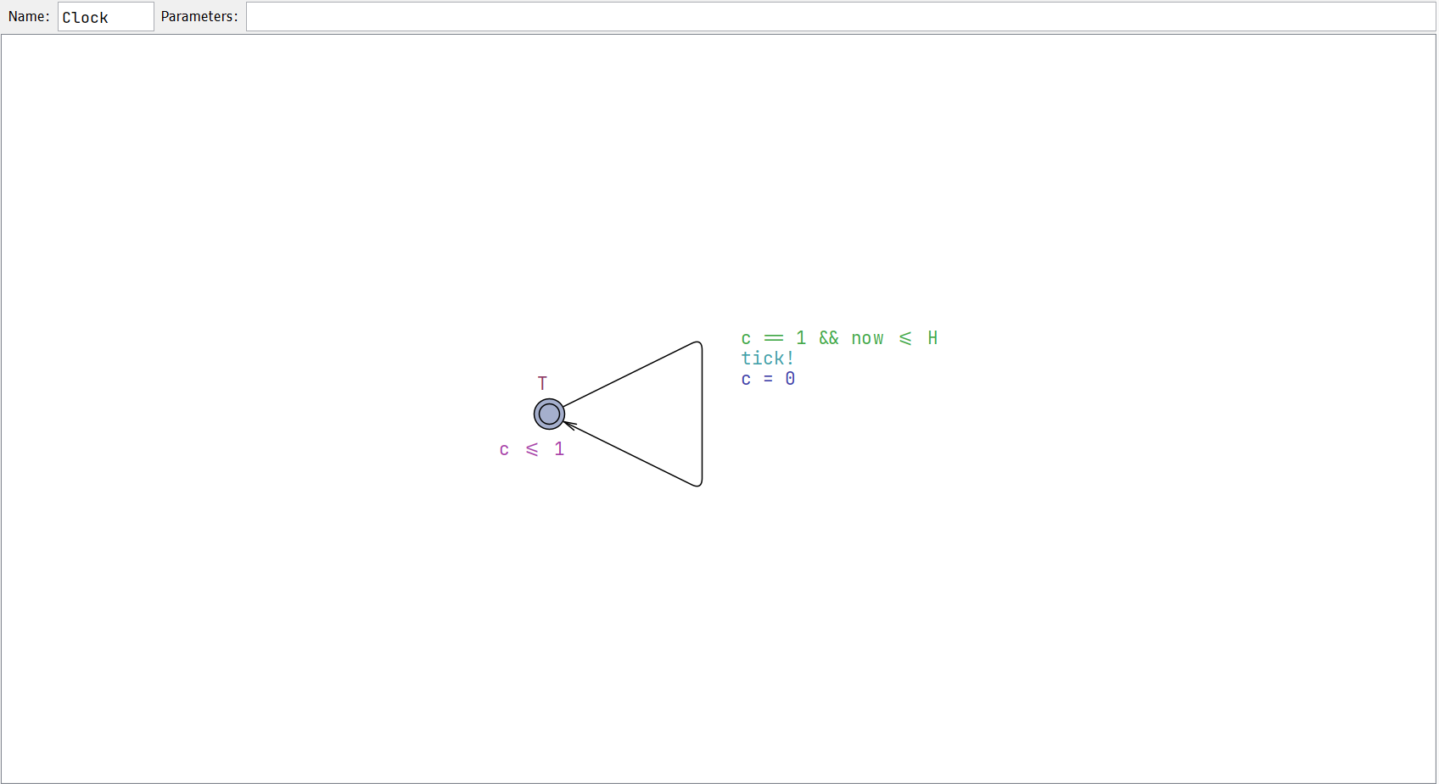
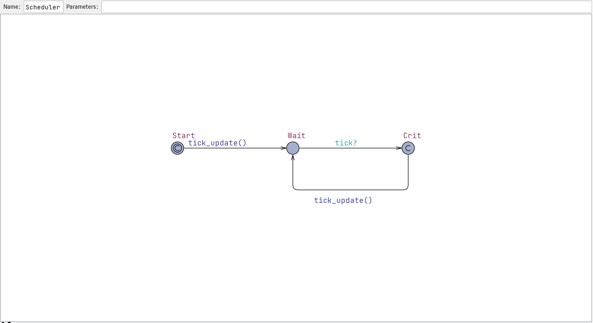
UPPAAL Implementation
Model components
Clock template sends tick every time unit
Scheduler receives tick and performs one atomic update
Update handles release, arrival, budget, replenishment, deadline check
Priority order: periodic task > Sporadic Server
UPPAAL shows timing logic
without needing a full RTOS implementation
Sporadic Server | Faysal Ahammed Tonmoy | ID 1230473
6

Slide 7
Parameters and Verified Properties
Parameters
Queries / checks
Tp = 4
period
Budget stays within valid bounds
Periodic task never misses deadline
Aperiodic queue remains bounded
Server becomes active
Budget can be exhausted
All modeled aperiodic jobs can be served
Cp = 1
periodic execution
Dp = 4
deadline
Cs = 2
server budget
Ts = 5
replenishment
QMAX = 3
queue bound
Most important query: A[] not miss
Sporadic Server | Faysal Ahammed Tonmoy | ID 1230473
7

Slide 8
Comparison with Other Approaches
Approach
Main idea
Weakness
Background
Idle time only
Slow response
Polling Server
Periodic check
Capacity wasted
Deferrable Server
Preserve capacity
More interference risk
Sporadic Server
Delayed replenishment
More bookkeeping
Slack Stealing
Use available slack
Complex
Sporadic Server | Faysal Ahammed Tonmoy | ID 1230473
8

Slide 9
Critical Evaluation and Final Message
Advantages
Limitations
Better response than background scheduling
Protects periodic hard tasks using bounded budget
Analyzable with Cs and Ts
Good for bounded irregular events
Needs accurate timer and budget accounting
More scheduler bookkeeping
Does not solve continuous overload
Shared resources need extra protocols
Final conclusion: Sporadic Server is strong for predictable systems with bounded aperiodic events, but not a universal solution.
Core references: Sprunt, Sha & Lehoczky (1989); Buttazzo (2011).
Sporadic Server | Faysal Ahammed Tonmoy | ID 1230473
9

Slide 10
Thank You

